Slide 1
TIME SERIES PREDICTION ON SALES OF WALMART
HKUST | MAFS
6010U Final Project
NAMELIST
LI, Han
LIU, Ruiyan
LI, Yijin
ZHANG, Tianyu
ZHANG, Xuanyu
ZHONG, Jing

Slide 2
CONTENTS
01
02
ARIMA
LSTM
03
04
Light GBM
Conclusion

Slide 3
1
ARIMA Model

Slide 4
ARIMA Model
Model Construction
Differentiate the sequence
The ARIMA (3,1,2) is adequate
DF test
The sequence is stationary
Divide Data
Training Set | Test Sets
Train Data
ARIMA(3,1,2) with smallest AIC
LB test
the residual is closed to WN

Slide 5
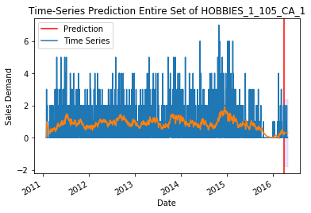
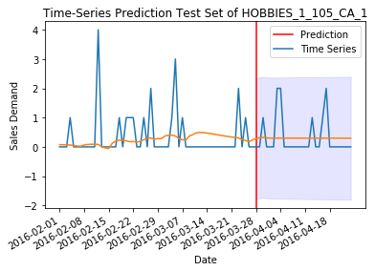
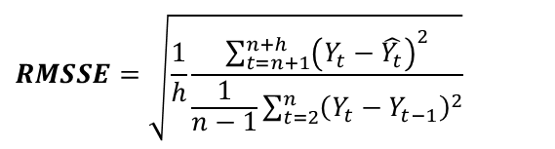
ARIMA Model
Model Prediction
the basic trend of series can be predicted by the model
For the test set, the ability to predict lower sales volume is stronger
RMSSE equals to 0.4358. In addition, we can also know that the in-sample RMSE is 1.0546 and out-sample RMSE is 0.6571
$$RMSSE=\sqrt{\frac{1}{h}\frac{\sum_{t=n+1}^{n+h}{{\left(Y_{t}−\hat{Y_{t}}\right)}^{2}}}{\frac{1}{n−1}\sum_{t=2}^{n}{{\left(Y_{t}−Y_{t−1}\right)}^{2}}}}$$

Slide 6
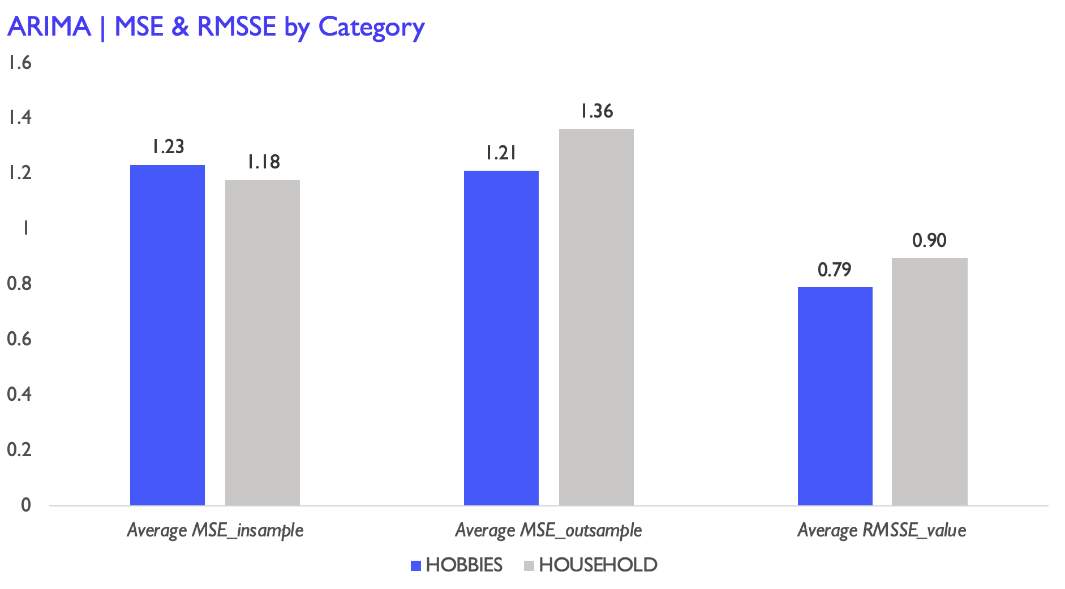
ARIMA Model
MSE & RMSSE of 1000 Products
BY Category
Shown as figures, in terms of categories, the average out-sample MSE and average RMSSE value of Household is higher than those of Hobbies.
But for in-sample, Hobbies has lower MSE than Household does .

Slide 7
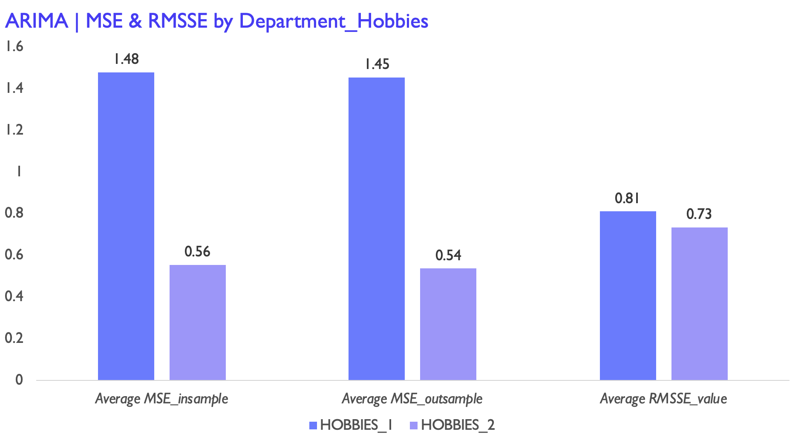
ARIMA Model
MSE & RMSSE of 1000 Products
BY Department
Looking into the Hobbies category, it is clearly that, compare with Hobbies 2, Hobbies 1 has lower MSE in- and- out sample as well as RMSSE.

Slide 8
2
LSTM
Network

Slide 9
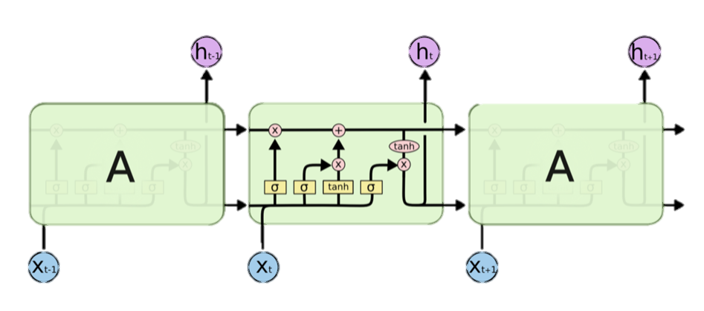
LSTM Network
Theoretical Basic
LSTM is a special kind of RNN, which is explicitly designed to avoid the long-term dependency problem. The structure of LSTM is shown on the left. It has three controllable gates (forget gate, input gate, output gate), which can control the memory and forgetting of the previous and current information .
We construct the single-layer and double-layer LSTM, and the flow chart is on the lower left.

Slide 10
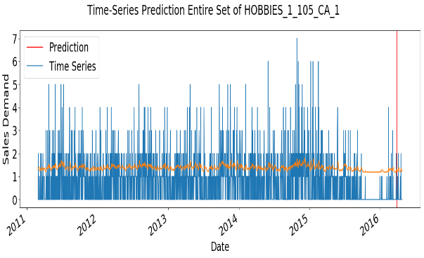
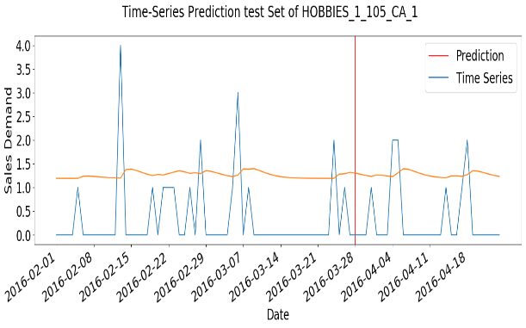
LSTM Network
Single-Layer
LSTM
The predicted value of this product sales fluctuate basically between 1 and 2 and the extreme values cannot be predicted accurately. On the test set, the predicted value is basically stable between 1 and 1.5.
In addition, the in-sample RMSE is 1.2076, out-sample RMSE and RMSSE is equal to 0.7755.

Slide 11
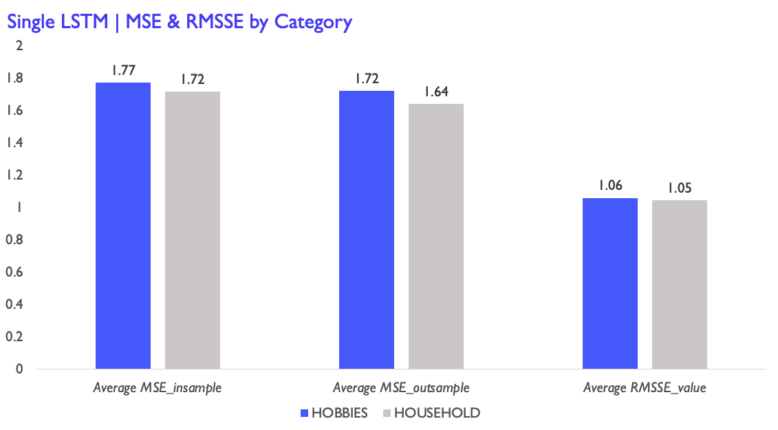
LSTM Network
MSE & RMSSE of 1000 Products
BY Category
In terms of categories, the average MSE and average RMSSE of Hobbies are all higher than those of Household

Slide 12
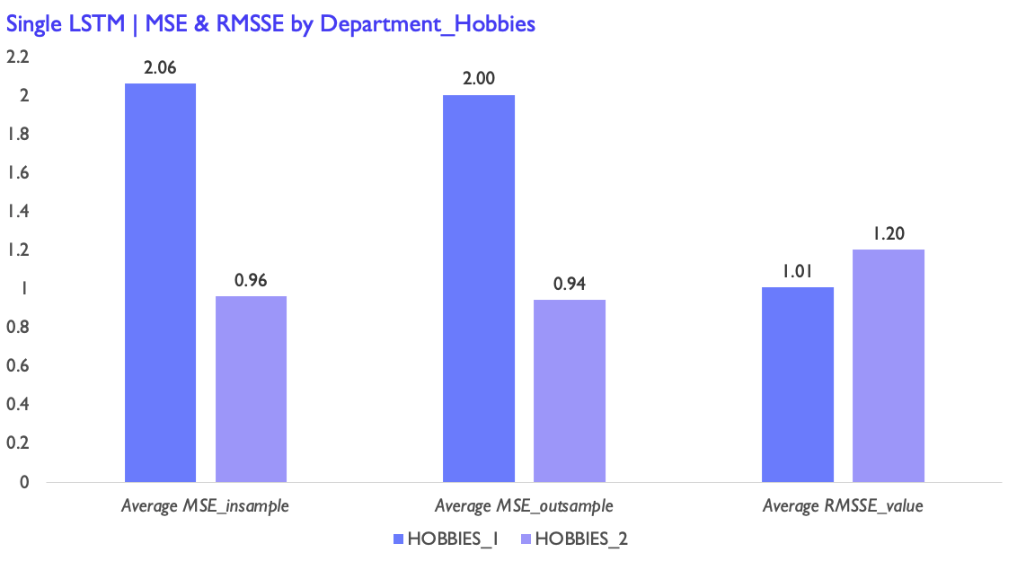
LSTM Network
MSE & RMSSE of 1000 Products
BY Department
Looking into the Hobbies category by department, for in- and- out sample, Hobbies 1 has higher MSE compare to Hobbies 2. As for the RMSSE, Hobbies 2 has higher RMSSE than Hobbies 1 does

Slide 13


LSTM Network
Multi-Layer
LSTM
By doing two-layer LSTM, the range of the predicted value on entire set basically fluctuates between 0.5 and 1.5. On the test set, the predicted value basically fluctuate between 0.5 and 1. The model's ability to predict the minimum value is enhanced, and the fluctuation of the predicted value is closer to that of the true value.
In-sample RMSE is 1.0809 and out-sample RMSE is 0.7895. We can also get RMSSE equal to 0.5249.

Slide 14
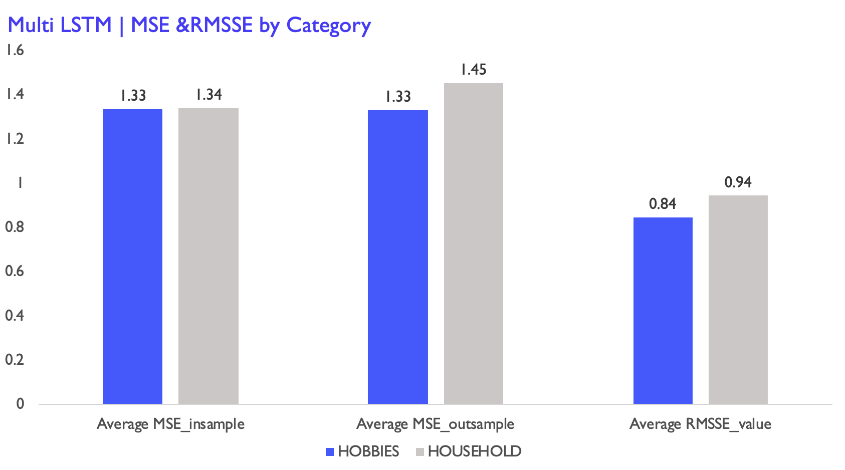
LSTM Network
MSE & RMSSE of 1000 Products
BY Category
In terms of categories, the average MSE and average RMSSE of Household are all higher than those of Hobbies

Slide 15
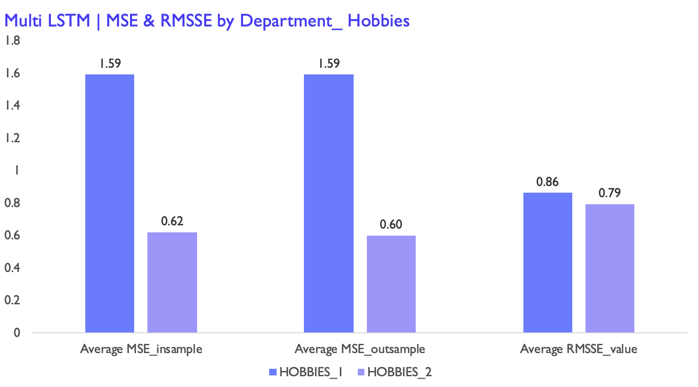
LSTM Network
MSE & RMSSE of 1000 Products
BY Department
Looking into the Hobbies category by department, for in- and- out sample, Hobbies 1 has higher MSE as well as RMSSE compare to Hobbies 2

Slide 16
3
Light GBM
Theory, implementation and results
Light GBM, proposed by Microsoft, is mainly used to solve the problems encountered by GBDT in massive data, so that it can be better and faster used in practice.

Slide 17
Improvement of Light GBM
Improvement
Gradient Based One Side Sampling
Histogram algorithm
Exclusive Feature Bundling (EFB) algorithm
XGBoost
Light GBM

Slide 18
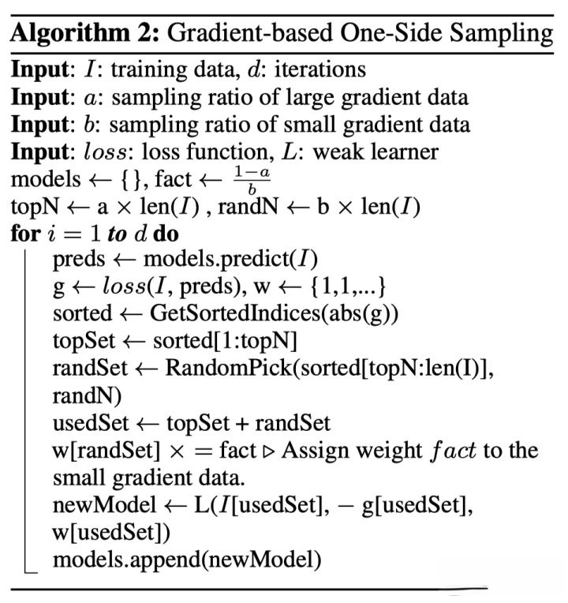
Theory and Algorithm
GOSS
The gradient size of GBDT algorithm can reflect the weight of samples. The smaller the gradient, the better the model fitting. The gradient based one side sampling algorithm (GOSS) uses this information to sample, reducing a large number of samples with small gradient. In the next calculation, only the samples with high gradient need to be paid attention to, greatly reducing the calculation amount.
We can see that GOSS sorts the samples based on the absolute value of the gradient in advance (without saving the result after sorting), and then gets the samples with a large gradient in the first a% and b% of the total samples. When calculating the gain, we can multiply (1-a)/b to enlarge the weight of samples with small gradient. On the one hand, the algorithm pays more attention to the samples with insufficient training. On the other hand, it multiplies the weight to prevent the sampling from causing too much influence on the distribution of original data.

Slide 19

Theory and algorithm
Histogram algorithm
The basic idea of histogram algorithm is to discretize continuous features into k discrete features and construct a histogram with width of K for statistical information. Using histogram algorithm, we can find the best splitting point by traversing K bin instead of traversing data.
When constructing the histogram of leaf node, we can also reduce the computation by half by subtracting the histogram of parent node from that of adjacent leaf node. In the practical operation, we can calculate the leaf nodes with small histogram first, and then use the histogram as the difference to get the leaf nodes with large histogram.

Slide 20
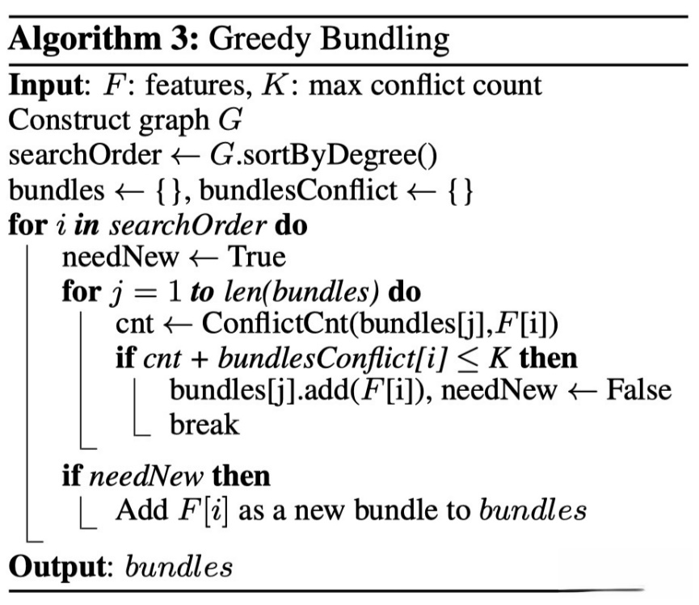
Theory and algorithm
EFB algorithm
High dimensional features are often sparse, and features may be mutually exclusive. If two features are not completely mutually exclusive, the mutual exclusion rate can be used to express the degree of mutual exclusion. The exclusive feature bundling (EFB) algorithm points out that if some features are fused and bound, the number of features can be reduced. So here comes a question: Which features can be bound together?
EFB algorithm constructs a weighted undirected graph based on the relationship between features and transforms it into graph coloring algorithm. Thus, we use greedy algorithm to get the approximate solution.
If the feature dimension reaches million level, the calculation amount will be very large. In order to improve efficiency, we propose a faster solution. The strategy of sorting according to node degree is changed to sorting according to non-zero value technology, because the more non-zero value, the greater the probability of mutual exclusion.

Slide 21
Implementation and results
Model Implementation
Model Results
Merge datasets and ignore some columns
Light GBM Algorithm
Fold No. | 1 | 2 | 3 | mean
val rmse score | 2.4492 | 2.3064 | 2.237 | 2.3309
Create some features in demand, price and time datasets
Date “2016-03-01” as node, split the data as train and test set
Use the selected features and parameters to run the Light GBM algorithm prediction section and calculate the “training's RMSE”, “valid_1's RMSE” and “val RMSE score” which are the performance evaluation standard.
The RMSE score is quite small and also shows the great efficient of our Light GBM algorithm.
Set Light GBM parameters
Run prediction section, calculate RMSE score

Slide 22
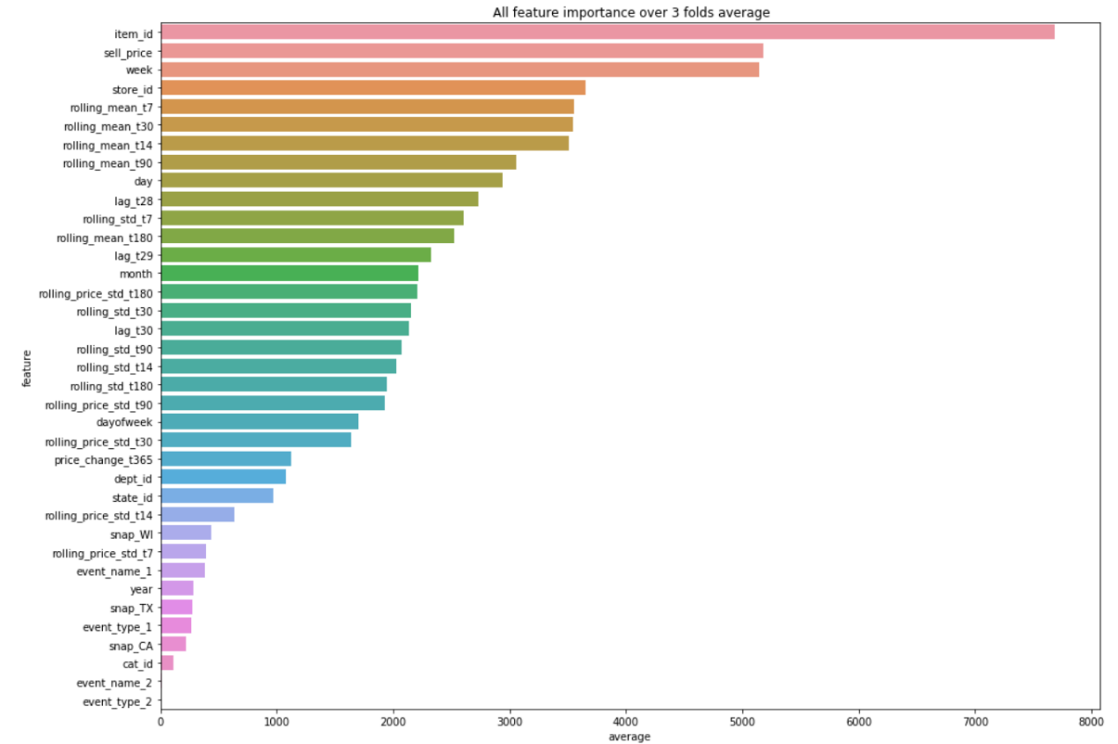
Implementation and results
Feature importance
The plot shows all feature importance over 3 folds in average. The top 4 contribution features are the basic features in the origin datasets. It shows that the features of demand rolling mean value in different time lag (rolling_mean_t7, rolling_mean_t14, rolling_mean_t30, rolling_mean_t90, rolling_mean_t180) have great contribution in our Light GBM algorithm.
Also, the rolling standard deviation of demand has much influence in the performance of algorithm. So it seems like the created features from demand dataset are valuable in Light GBM algorithm prediction and for the further research, we may focus more on the demand dataset and dig in more useful feature information.

Slide 23
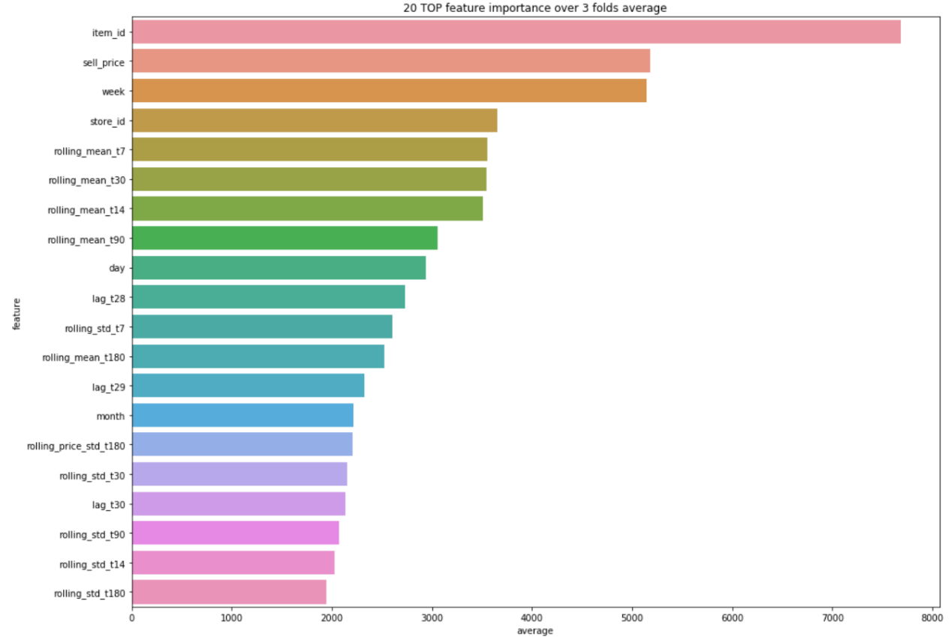
Implementation and results
Feature importance
We also present the plot of the top 20 feature contribution in the 3 folds.
This allows us to select useful features more clearly, and we can eliminate features that contribute less, in order to improve the efficiency and performance of the algorithm.

Slide 24
4
Conclusion

Slide 25
Conclusion
Present 3 different models: ARIMA, LSTM, Light GBM, it shows that LSTM and Light GBM algorithms can fit the prediction in sales of Walmart.
Calculate RMSE in prediction section, RMSE in different models are all quite small, which means these algorithms all have good performance.
Show feature importance in Light GBM, focus more on the features with great contribution.

Slide 26
THANK
YOU!
HKUST
MAFS6010U

